Slide 1


Huffman coding for a large text
Carried out by-
MANAN SAHLOT (1RN17IS051)
AMULYA BHANDE (1RN17IS011)
MOHANA PRIYA A (1RN17IS057)

Slide 2
CONTENTS
Overview
Introduction
Aim of the project
Algorithm
Implementations
Results
Application
Conclusions
Future enhancements
References

Slide 3
Overview
Huffman coding is based on the frequency of occurrences of a data item.
Huffman coding assigns codes to characters such that the length of the code depends on the relative frequency or weight of the corresponding character. Thus, it is a variable-length code
The principle is to use a lower number of bits to encode the data that occurs more frequently.
Unique Prefix Property:
no code is a prefix to any other code (all symbols are at the leaf nodes) - great for decoder, unambiguous.
Notes:
3

Slide 4
Introduction
Huffman coding is a popular technique for data compression. It’s frequencies
of occurrence of each character in a file to come up with an optimal way of
representing each character as a binary string.
An effective and widely used application of binary trees and priority queues.
Developed by David.A.Huffmann while he was a Ph.D. student at MIT and
published in the 1952 paper “a method for the construction of minimum
redundancy codes”.
Each code in a binary string that is used for transmission of the corresponding
message.

Slide 5
Aim of the project
To convert the large text into the binary code
The output from Huffman algorithm can be viewed as a variable length code table for encoding a source symbol
Implement the Huffman Coding algorithm, analyze a text file, and print out the codes for each letter.

Slide 6
Algorithm technique-
Huffman coding is based on greedy algorithm technique.
Algorithm steps-
Create a leaf node for each unique character and build a min heap of all leaf nodes (Min Heap is used as a priority queue. The value of frequency field is used to compare two nodes in min heap. Initially, the least frequent character is at root).
Extract two nodes with the minimum frequency from the min heap.
Create a new internal node with a frequency equal to the sum of the two nodes frequencies. Make the first extracted node as its left child and the other extracted node as its right child. Add this node to the min heap.

Slide 7
Repeat steps#2 and #3 until the heap contains only one node. The remaining node is the root node and the tree is complete.
Time complexity: O(nlogn) where n is the number of unique characters. If there are n nodes, extractMin() is called 2*(n – 1) times. extractMin() takes O(logn) time as it calles minHeapify(). So, overall complexity is O(nlogn).

Slide 8
Implementation
A Tree node
class Node
{
char ch;
int freq;
Node left = null, right = null;
Node(char ch, int freq)
{
this.ch = ch;
this.freq = freq;
}
public Node(char ch, int freq, Node left, Node right) {
this.ch = ch;
this.freq = freq;
this.left = left;
this.right = right;
}
};

Slide 9
class Huffman
{
// traverse the Huffman Tree and store Huffman Codes in a map.
public static void encode(Node root, String str, Map<Character, String> huffmanCode)
{
if (root == null)
return;
// found a leaf node
if (root.left == null && root.right == null) {
huffmanCode.put(root.ch, str);
}
encode(root.left, str + "0", huffmanCode);
encode(root.right, str + "1", huffmanCode);
}

Slide 10
traverse the Huffman Tree and decode the encoded string -
public static int decode(Node root, int index, StringBuilder sb)
{
if (root == null)
return index;
// found a leaf node
if (root.left == null && root.right == null)
{
System.out.print(root.ch);
return index;
}
index++;
if (sb.charAt(index) == '0')
index = decode(root.left, index, sb);
else
index = decode(root.right, index, sb);
return index;
}

Slide 11
Builds Huffman Tree and huffmanCode and decode given input text
public static void buildHuffmanTree(String text)
{
// count frequency of appearance of each character
// and store it in a map
Map<Character, Integer> freq = new HashMap<>();
for (int i = 0 ; i < text.length(); i++) {
if (!freq.containsKey(text.charAt(i))) {
freq.put(text.charAt(i), 0);
}
freq.put(text.charAt(i), freq.get(text.charAt(i)) + 1);
}
// Create a priority queue to store live nodes of Huffman tree
// Notice that highest priority item has lowest frequency
PriorityQueue<Node> pq = new PriorityQueue<>(
(l, r) -> l.freq - r.freq);
// Create a leaf node for each character and add it
// to the priority queue.
for (Map.Entry<Character, Integer> entry : freq.entrySet()) {
pq.add(new Node(entry.getKey(), entry.getValue()));
}

Slide 12
// do till there is more than one node in the queue
while (pq.size() != 1)
{
// Remove the two nodes of highest priority
// (lowest frequency) from the queue
Node left = pq.poll();
Node right = pq.poll();
// Create a new internal node with these two nodes as children
// and with frequency equal to the sum of the two nodes frequencies. Add the new node to the priority queue.
int sum = left.freq + right.freq;
pq.add(new Node('\0', sum, left, right));
}
// root stores pointer to root of Huffman Tree
Node root = pq.peek();
// traverse the Huffman tree and store the Huffman codes in a map
Map<Character, String> huffmanCode = new HashMap<>();
encode(root, "", huffmanCode);
// print the Huffman codes
System.out.println("Huffman Codes are :\n");
for (Map.Entry<Character, String> entry : huffmanCode.entrySet()) {
System.out.println(entry.getKey() + " " + entry.getValue());
}
System.out.println("\nOriginal string was :\n" + text);

Slide 13
print encoded string-
StringBuilder sb = new StringBuilder();
for (int i = 0 ; i < text.length(); i++) {
sb.append(huffmanCode.get (text.charAt(i)));
}
System.out.println("\nEncoded string is :\n" + sb);
traverse the Huffman Tree again and this time decode the encoded string
int index = -1;
System.out.println("\nDecoded string is: \n");
while (index < sb.length() - 2) {
index = decode(root, index, sb);
}
}
Main function()-
public static void main(String[] args)
{
String text = "Huffman coding is an data compression algorithm.";
buildHuffmanTree(text);
}
}

Slide 14
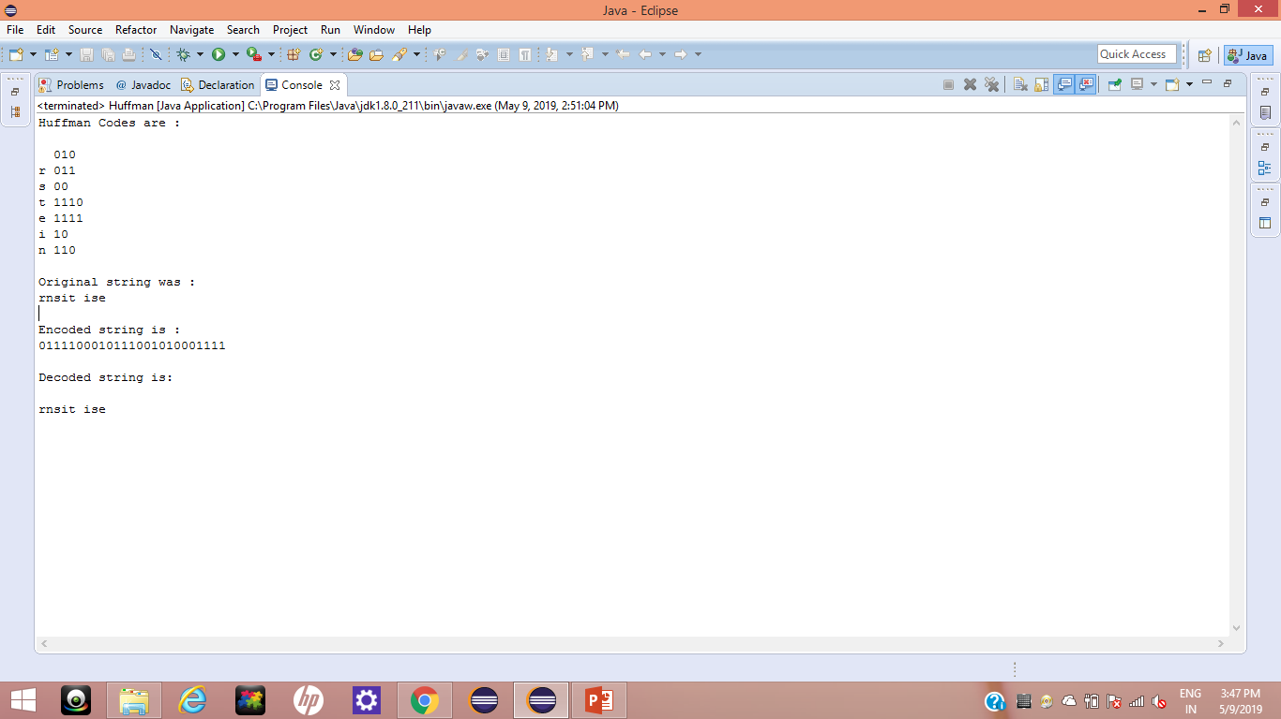
Results

Slide 15
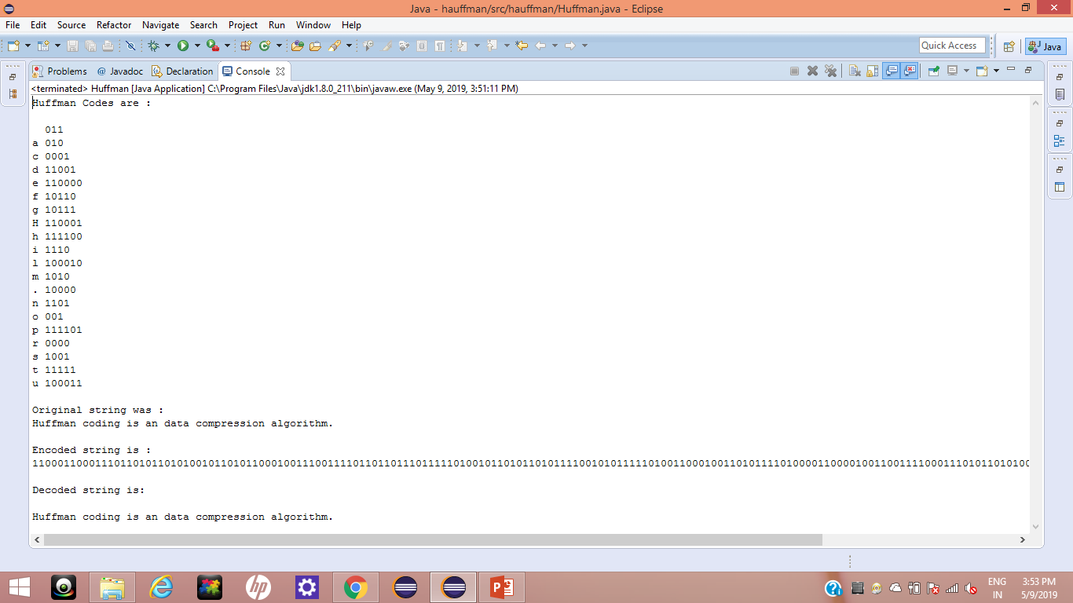

Slide 16
Applications
ENCODING AND COMPRESSION OF DATA-
FAX MACHINES
ASCII
VARIATIONS ON ASCII-
Min no. of bits needed
Cost of savings
Patterns
savings
Huffman coding is used to compress files for transmission

Slide 17
Conclusion
Huffman coding is an technique used to
compress files for transmission
Uses statistical coding – more frequently used
symbols have shorter code words
Works well for text and fax transmission
An application that uses several data structures

Slide 18
Future enhancements
The key objective is to invent a technique to compress the tree size of Huffman compression by a memory efficient representation of Huffman tree.
Significant improvements of the tree compression ratio will enhance the data compression ratio.
Then designing encoding and decoding algorithm for new technique so that encoding and decoding is accomplished with minimal effort.

Slide 19
References
DAA notes
www.codeacamey.com
www.google.com
www.wikipedia.com

Slide 20


